Slide 1
GLOBES AND MAPS
Geography Lesson-4

Slide 2
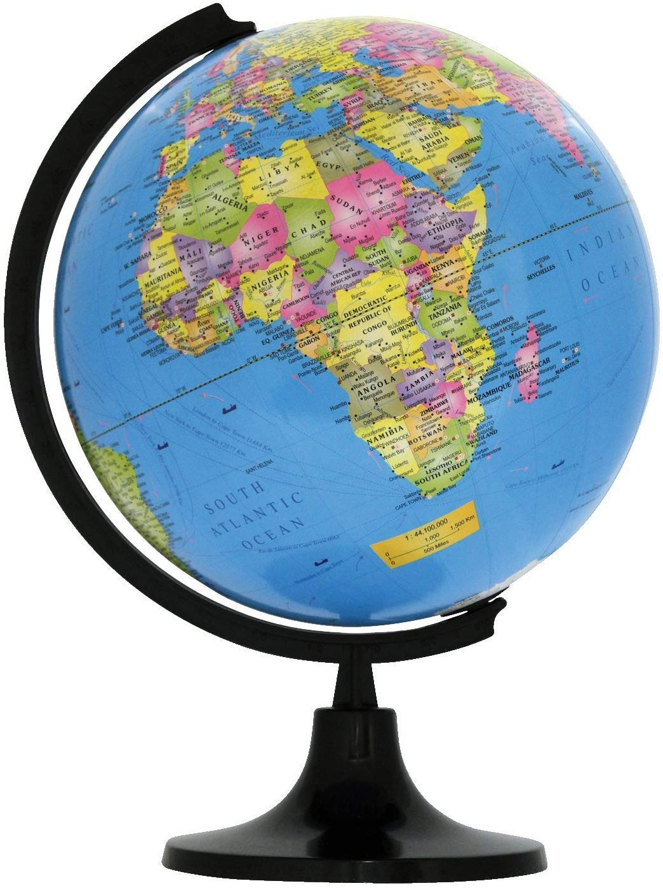
A Globe
It is very tough to see the entire earth in one time. Even photos took through satellites show only half of the earth. So, the representation of earth through a model is called a globe.

Slide 4
Advantages: | Disadvatages
Can be carried easily | Don’t show perfect shape.
They can show the earth's entire surface or just a small part and can show even a small locality in a great detail. | They quickly become outdated because of development of cities.

Slide 5
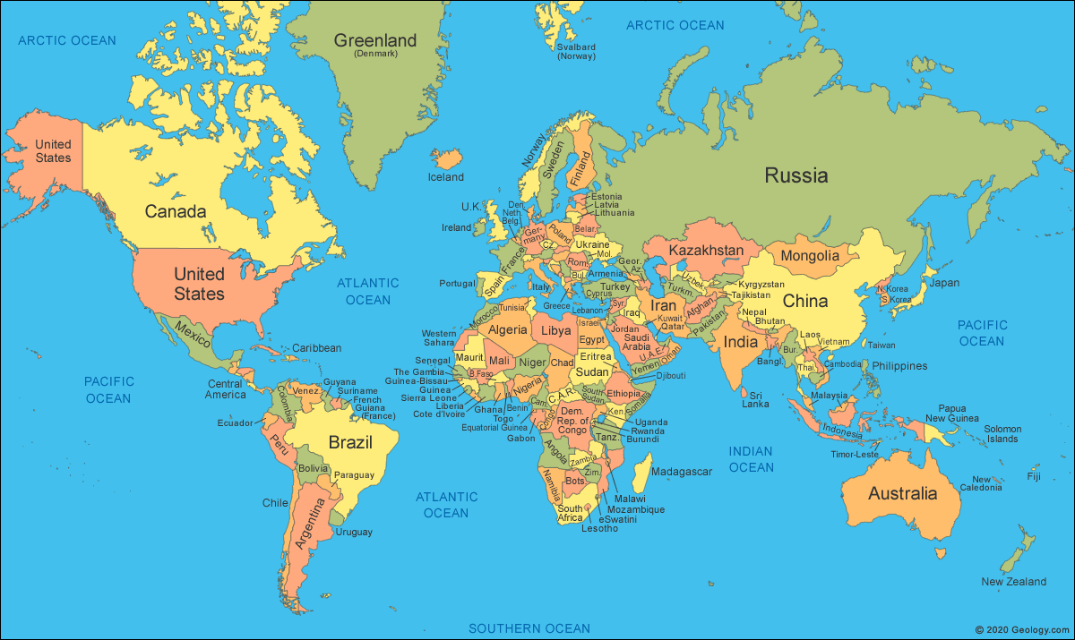
Map
A globe cannot be carried to different places. It is very tough to carry.in such reasons we can use a map. Representation of earth in a flat surface is called a map. A book of map is called as a atlas. Mercator and Hondt were the first to publish a collection of map.

Slide 6
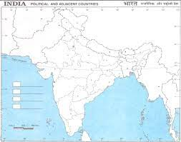
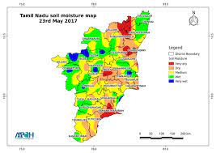
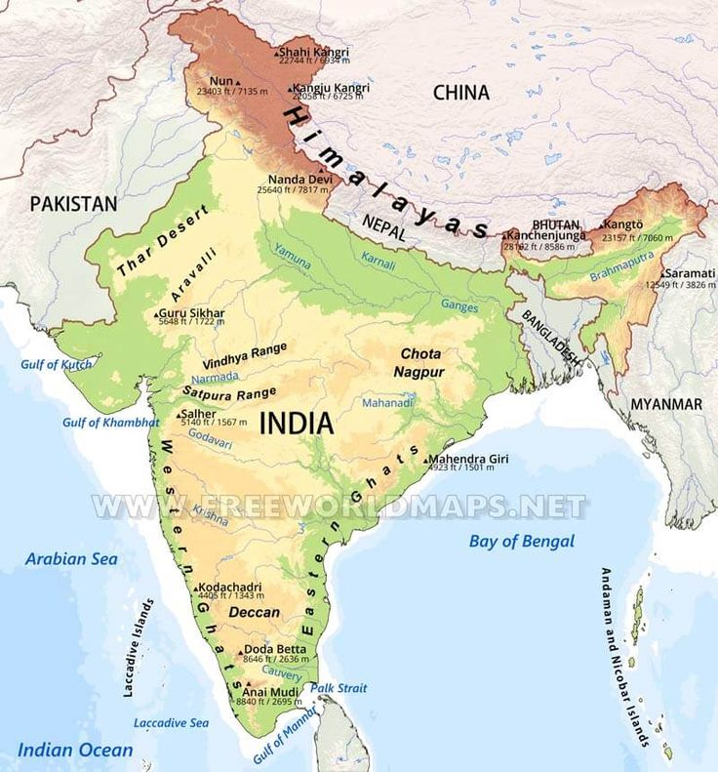
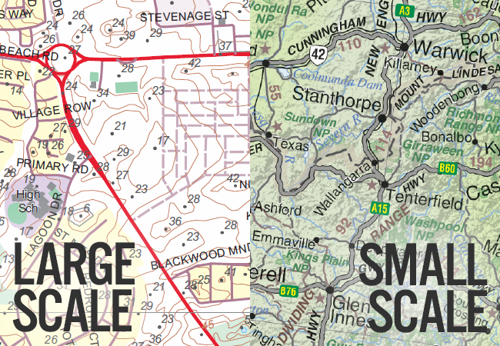
Types of Maps
Large scale maps, Small scale maps, political maps and thematic maps are different types of maps.
Small Scale maps: Shows a large area with less details.
Large Scale maps: Shows a small area with clear details.
Physical maps: Shows mountains,platues,plains, valleys, etc.
Political map: Shows the outlines between different countries and political units between a state.
Thematic map: Shows specific information such as roads, railways, population, etc.

Slide 7
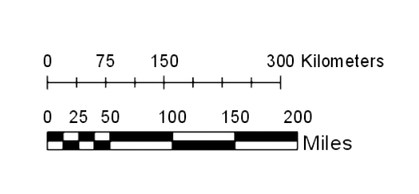
Measuring distance
Distance means far or near. The distance shown tell us that, weather it is far or near. So, the distance shown in a map is very important. A map scale is used to show the actual distance and the difference in the distance shown in the map.

Slide 8
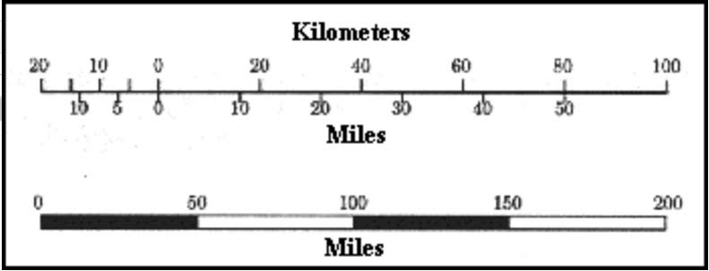
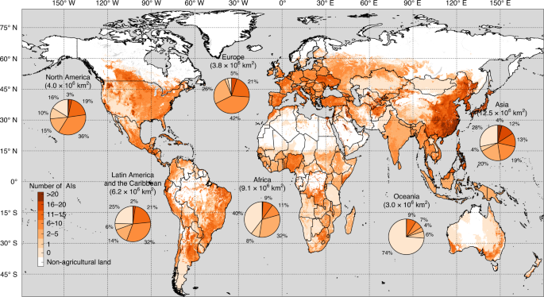
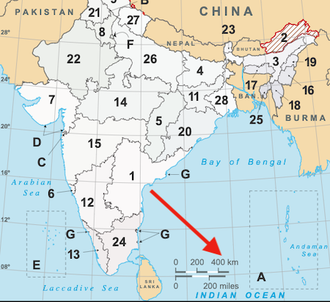
MAP SCALE (In Detail)
How can a map scale show on a map?
By a statement, by a numerical fraction, by a GRAPHIC or LINEAR SCALE.

Slide 9
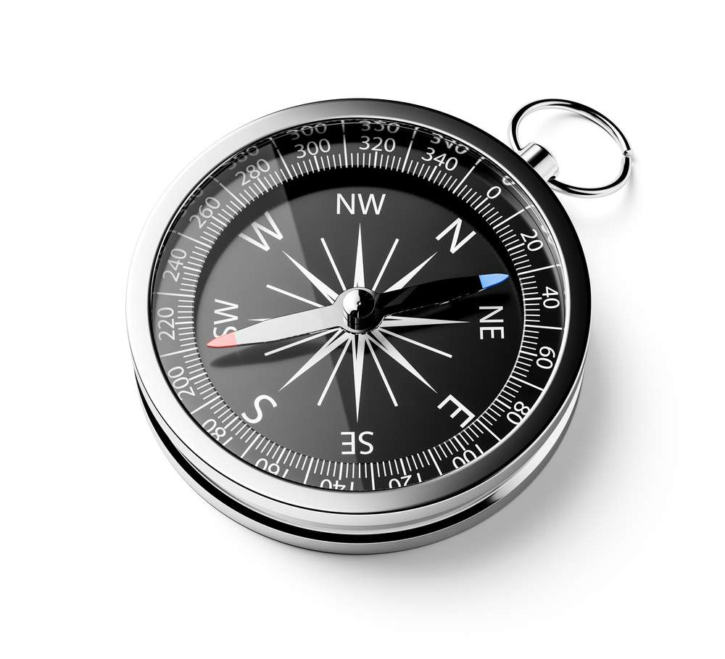
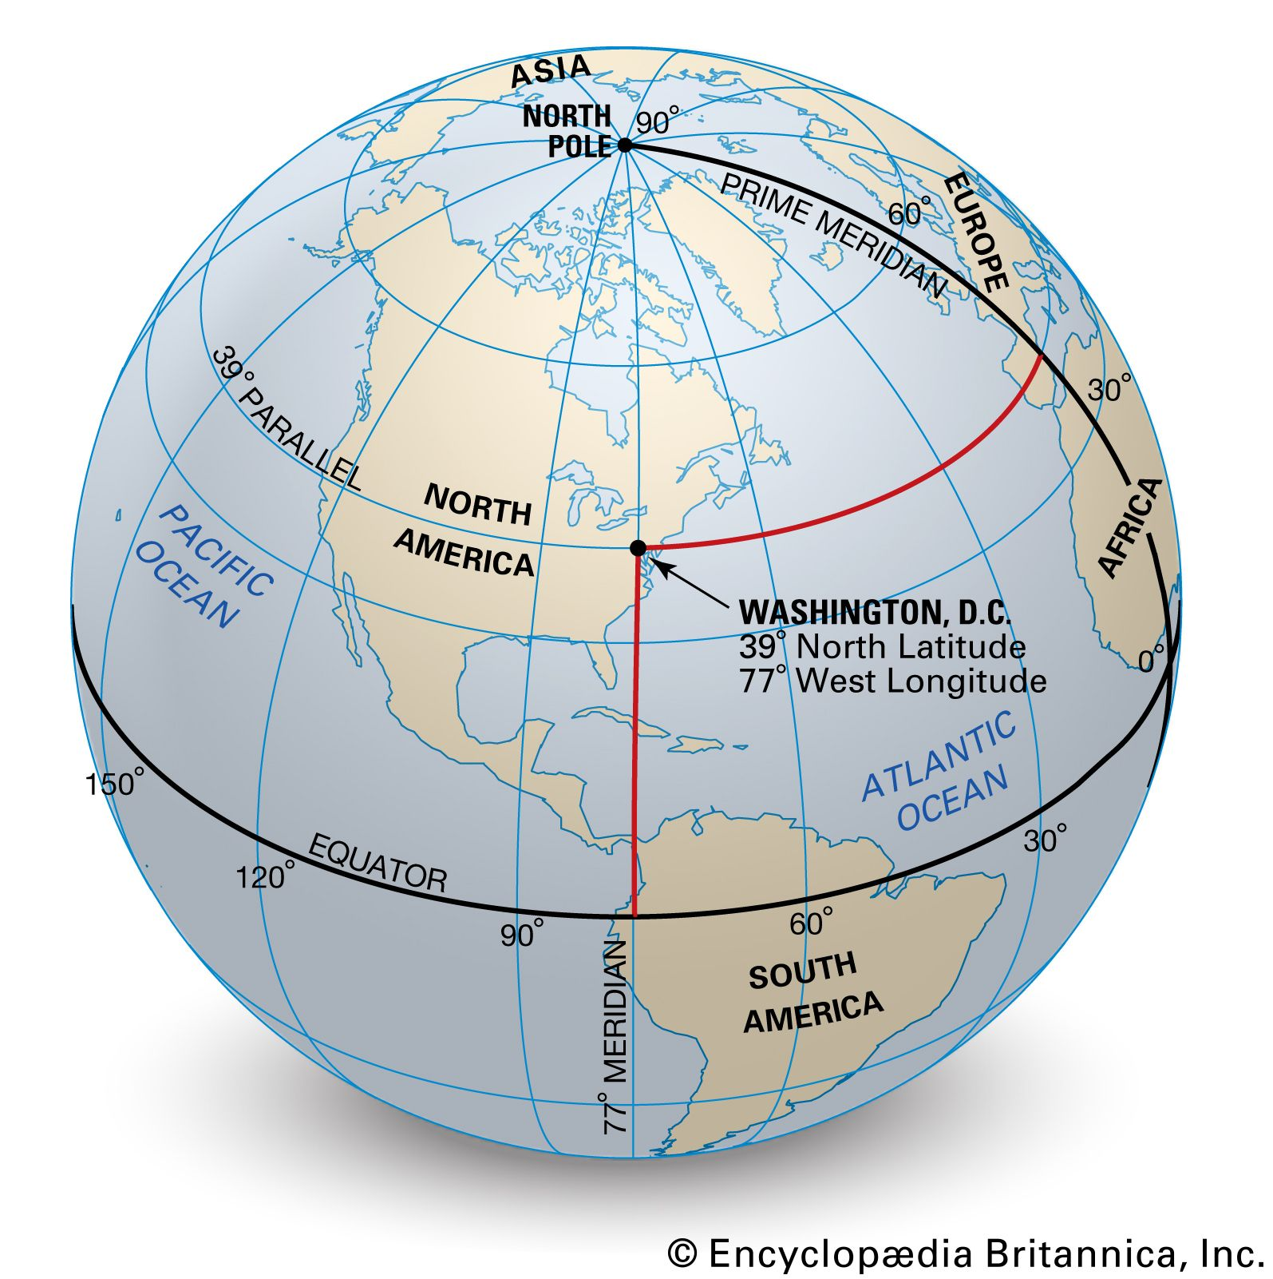
Finding Directions
North, south, east and the west are the four direction. Directions on the map is represented with a help of a arrow. The arrow on the map is called the north line. This north line always shows the north direction. If we find the north, we can easily find the other directions. If find these 3 directions, we can find the other directions such as east west, north-east, etc. An easy way of finding direction is though sun rise and pole star. We all know that the sun rises in the east and sets at the west. Even we can find the direction using pole star. This pole star show the north. So, we find the other directions. Even we can use a compass .

Slide 10
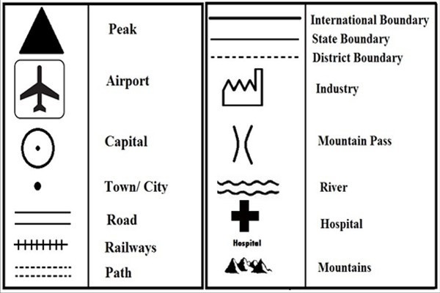
CONVENTIONAL SIGNS AND SYMBOLS
There is no sufficient space in the map to show mountains, plateaus, plains, etc. So different symbols and signs are used in the map. The map shows us many symbols and colors to show many places such as boundaries, climatic conditions, transport system, etc. Even different colours are used in the map to represent these things.

Slide 11
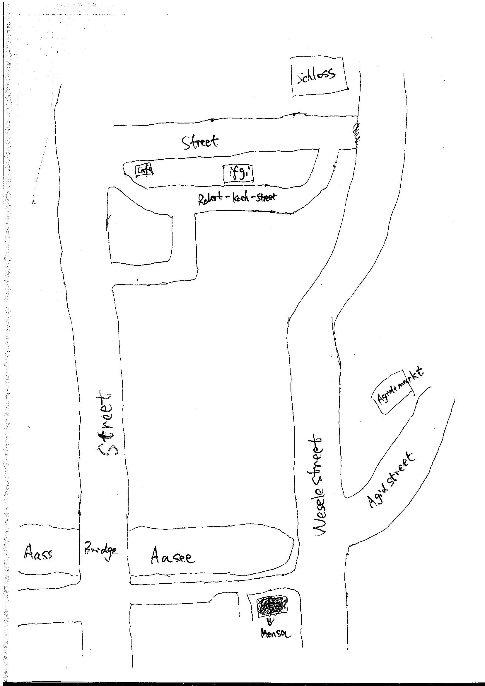
Sketch
A rough diagram, which is drawn without measuring distance between various places, this is called a sketch.

Slide 12
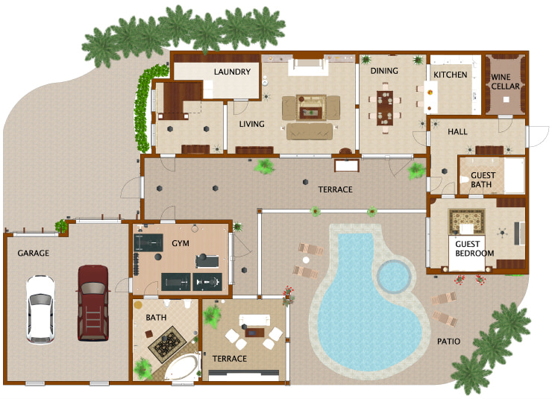
Plan
Sometimes, we want to draw a small map for a small area such as our house with accurate information. This is called a layout plan. This shows us accurate details without a leaving a small window. On the other hand, a plan representing a small area in large scale.

